Slide 1
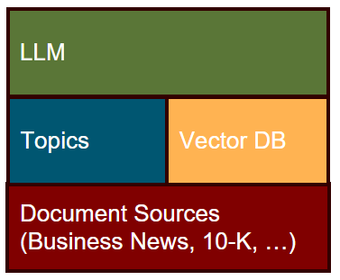
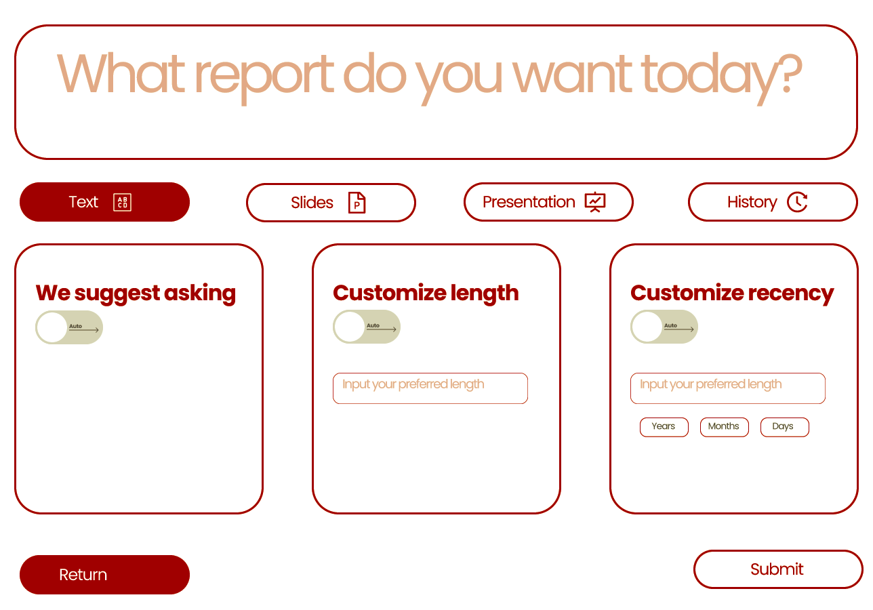
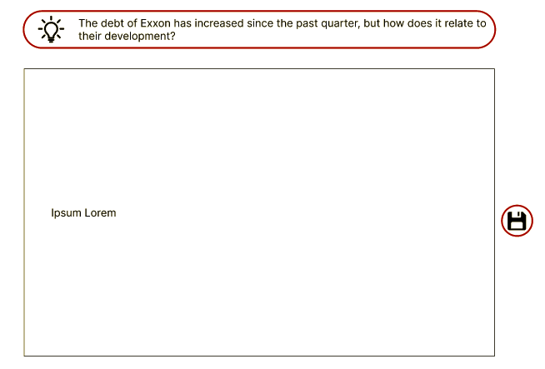
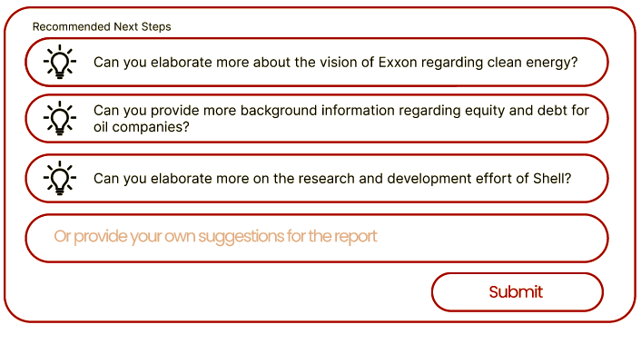

MScA team Null Capstone: FinBot
Project Idea
Overview of Current Schematics
Product Name:
FinBot
Final Product:
AI that takes in user questions or investment ideas and generate answers and suggestions through interactive conversations and (or) visual explanations
Topic based grouping of documents
Vector DB powered document retrieval
Fine-tuned LLM for content synthesis
Document summarization
Topic ranking & interpretation
Report generation
UX Flow
1. User specify format of response and ask question
2. User receive report with specified format
3. User ask follow-up questions and interact with FinBot
E
Team Members: Shilong Dai, Yif Wang, Shefali Gupta, Snigda Gedela, Takuma Koide

